Slide 1

Aircraft Risk Assessment for Expansion
Advisory Report to Aviation Division

Slide 2
Aircraft Risk Assessment for Expansion
Advisory Report

Slide 3
Defining the Business Problem
The company wants to expand and is interested in purchasing airplanes for commercial and private enterprises.
The aviation dataset will aid in determining which aircraft are low risk for the company to start the new business endeavors.

Slide 4
Data
Data was sourced from aviation accident records covering the period 1948 to 2022. We analyzed accident counts per plane manufacturer, per the number of engines each plane had etc .
The data was cleaned to ensure that the results of the analysis are accurate by removing duplicated rows and null values.

Slide 5
Understanding the Context
Understanding the factors leading to aviation accidents will aid in determining the most suitable aircraft to be used by the company.
The dataset used in this project comes from aviation accident reports covering the period 1948 to 2022.
It contains detailed records of accidents, including aircraft manufacturer, number of engines, engine type, accident dates, and other attributes.

Slide 6
Executive Summary
The analysis of historical aviation accident data identified significant differences in risk across aircraft models. By calculating number of accident per plane make and model, we created a composite risk score. This score highlights safer aircraft models suitable for initial purchases as the company expands into aviation.

Slide 7
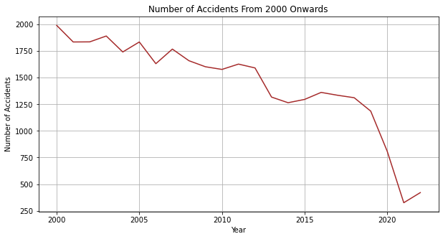
Accident Trends From 2000 0nwards
This graph shows that the frequency of aircraft accidents has gradually decreased from 2000 to 2022. This indicates that aviation safety standards and technologies are improving over time which reduces overall busssiness risk for entering the industry today.

Slide 8
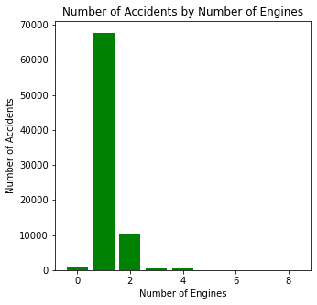
Accidents by Number of Engines
The graph shows how the number of engines a plane has relate to the rate of accidents

Slide 9
Conclusion
This project analyzed aviation accident data to support the company’s expansion into the aviation industry.
The key findings are:
Manufacturers with higher accident frequencies should be approached with caution. Safer manufacturers may represent better long-term investments.
Aircraft with more engines tend to show lower accident counts, suggesting that simpler designs may reduce risk for the company’s fleet.
Engine type matters – certain engine types (e.g., turbojet, reciprocating) show different accident profiles, which should guide selection.
Accident frequency has declined significantly since 2000, indicating that modern aircraft generally have improved safety standards.

Slide 10
Recommendations
Prioritize the acquisition of models from the top 10 safest list
Focus purchases on manufacturers with lower accident counts.
Prioritize aircraft with 2 or more engines and modern engine types.
Favor newer aircraft models since accident trends show continuous safety improvements.

Slide 11
Thank You – Questions?

